Slide 1
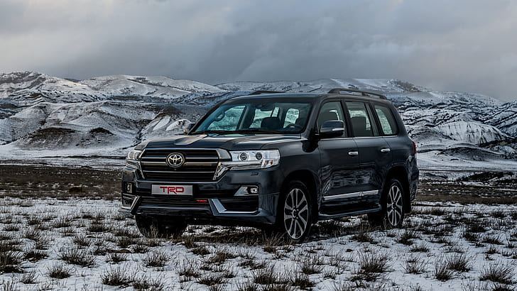
Buycar.kg cars of new generation

Slide 2
About our company
A convenient service where you can purchase models of all popular car brands at the most affordable prices on the market. Car dealership "Buycar.kg" directly cooperates with well-known car brands, being an authorized dealer.
The company's website contains an electronic catalog in which you will find hundreds of proposals for every taste. Each of the models has a detailed description, technical specifications, photos and prices. In order to see and choose cars "live", you should visit the showroom of the company, which has a convenient location, being close to highways and public transport stops. In a spacious and bright hall, managers will hold a presentation and help you make a choice, which you can finally establish yourself in at the test drive site located here.
1

Slide 3
About our company
The main advantages of the car dealership Buycar.kg:
a huge range of cars;
acceptable prices;
the opportunity to get a car loan for a period of up to 7 years, at a favorable rate of 4.5% per annum, as well as an interest-free installment plan.
there is a trade-in program for the exchange of old cars for new ones;
there are discounts;
you can order the installation of additional equipment without loss of warranty.

